Slide 1
Williamsport Little League Basic Baseball Rules and Understandings
NJ State Federation of Umpires
Bob Ciriello - April 23, 2018

Slide 2
New 2018 LL Baseball Rules
Playing Rule 1.10 - The Bat.
Divisions: Junior League Baseball divisions and below.
Synopsis: The bat must be a baseball bat which meets the USA Baseball Bat standard (USABat)
as adopted by Little League. It shall be a smooth, rounded stick, and made of wood or of material
and color tested and proved acceptable to the USA Baseball Bat standard (USABat).
Summary: Non-wood and laminated bats shall bear the USA Baseball logo signifying that
the bat meets the USABat - USA Baseball’s Youth Bat Performance Standard.
All BPF - 1.15 bats will be prohibited.
NOTE: BBCOR bats are allowed in Senior / Junior / Intermediate (50/70) Divisions.

Slide 3
New 2018 LL Baseball Rules
Playing Rule 3.03 - Game Preliminaries.
Divisions: All
Synopsis: This would revise the substitution rule for all divisions of play for the Regular Season.
Summary: A player in the starting line-up who has been removed for a substitute may
re-enter the game, in the SAME position in the batting order, provided:
(a) his or her substitute has completed one time at bat and;
(b) has played defensively for a minimum of six (6) consecutive outs;
NOTE: A substitute may not be removed from the game prior to completion of his/her
mandatory play requirements.

Slide 4
New 2018 LL Baseball Rules
Playing Rule 4.10(e) - Starting and Ending the Game.
Divisions: All
Synopsis: This allows a local league to implement a 15-run rule after three innings
[four innings for Intermediate (50-70) Division/Junior/Senior League].
This would be mandatory during the International Tournament.
Summary: If after three (3) innings, two and one-half innings if the home team is ahead,
one team has a lead of fifteen (15) runs or more, the manager of the team with the least runs
shall concede the victory to the opponent.
If after four (4) innings, three and one-half innings if the home team is ahead, one team has
a lead of ten (10) runs or more, the manager of the team with the least runs shall concede the
victory to the opponent.
NOTE:
(1) If the visiting team has a lead of fifteen (15) or ten (10) runs or more respectively,
the home team must bat in its half of the inning.
(2) The local league may adopt the option of not utilizing this rule.

Slide 5
New 2018 LL Baseball Rules
Playing Rule 8.06 (a) and (b) - The Pitcher.
Divisions: Major division and above.
Synopsis: This reduces the number of visits to a pitcher to twice in one inning or three times
in a game for the Major Division and above. (Minors and below is still 3 per inning / 4 per game.)
Summary: This rule, which applies to each pitcher who enters a game, governs the visits of the
manager or coach to the pitcher at the mound.
A manager or coach may come out once in one inning to visit with the pitcher, but the
second time out, the player must be removed as a pitcher.
(b) A manager or coach may come out twice in one game to visit with the pitcher, but the
third time out, the player must be removed as a pitcher.
NOTE: This rule applies to each pitcher who enters a game.

Slide 6
New 2018 LL Baseball Rules
Regulation VI (d) – Pitchers.
Divisions: All divisions of Baseball.
Synopsis: This restricts a player from pitching in three consecutive days in Regular Season
and Tournament.
Summary: Under no circumstances shall a player pitch in three (3) consecutive days.
Existing Rule, General Pitching reminder regarding Balks:
On the 46/60 diamond (Little League and Minor Level) - No Balks (8.05)
On the 50/70 and 60/90 diamond - Balks can be called, and the ball is LIVE.
If the batter swings and hits the balk pitch let the play continue, it is a delayed dead ball.
Offensive team manager can decline the penalty and accept the outcome of the play.

Slide 7
LL Field and Equipment
Field:
Pitching Plate Distance: 46 feet
Base Line Length: 60 feet
Double First base is permissible (7.15)
Batter’s Box: 6’ x 3’
Catcher’s Box: 9’ triangle
No on-deck area
Team:
One (1) manager
Up to two (2) additional coaches (3.17)
Adult manager or coach must be in dugout at all times
Eligible, uniformed players only allowed in dugout
No “bat boys”

Slide 8
LL Field and Equipment
Bats (1.10): New in 2018
Max Diameter: 2 5/8 inches Max Length: 33 inches
Non-wood and laminated bats shall bear the USA Baseball logo
signifying that the bat meets the USABat – Performance Standard.
All BPF - 1.15 bats will be prohibited.
No Donuts
Catchers (1.17):
All catchers MUST have “dangling” throat protector
Since 2015 - “long” model chest protector is optional
Pitchers (VI):
Pitch count is in effect for all games. Required rest days
depends upon number of pitches thrown in a day.
Maximum of 85 pitchers per day (11-12 yr. old)
Pitcher can not move to catcher if 41+ pitches thrown.

Slide 9
General LL Baseball Rules
Mandatory Play (IV):
All players must play a minimum of 6 defensive outs and 1 at bat.
Number of players:
Must START with 9 fielders (4.16)
Must END with 9 fielders (4.17)
Batting Order has 2 options:
1 - Bat 9 players with subs (3.03)
2 - Continuous batting order (4.04)
No penalty for skipping over an injured or absent batter.
Coaches decision on allowing late arriving player to enter game.
Courtesy or “speed up” runners are not allowed (3.04)
“Special Pinch Runner” (7.14) can be used if batting 9 with subs.

Slide 10
General LL Baseball Rules
Game Length (4.10):
6 innings. 10 run difference, game ends after 4 (3 ½) inn. New in 2018 - League Optional, 15-run rule after three innings
Base Runners:
Runner can not leave base until pitched ball reaches batter (7.13)
Violation by any runner affects all other base runners.
Since 2012 - Dropped 3rd strike rule is in effect (6.05b).
Batter-runner is NOT out if he over runs first base on walk
if he returns immediately to 1st base. (7.08c Exception)
(Unless runner makes an attempt to advance to 2nd.)
Pitching:
No Balks in Little League baseball (8.05)
Trips to the pitcher (8.06) - New in 2018 # trips reduced by one
Per pitcher
2 trips in an inning, 3 trips in a game then removed

Slide 11
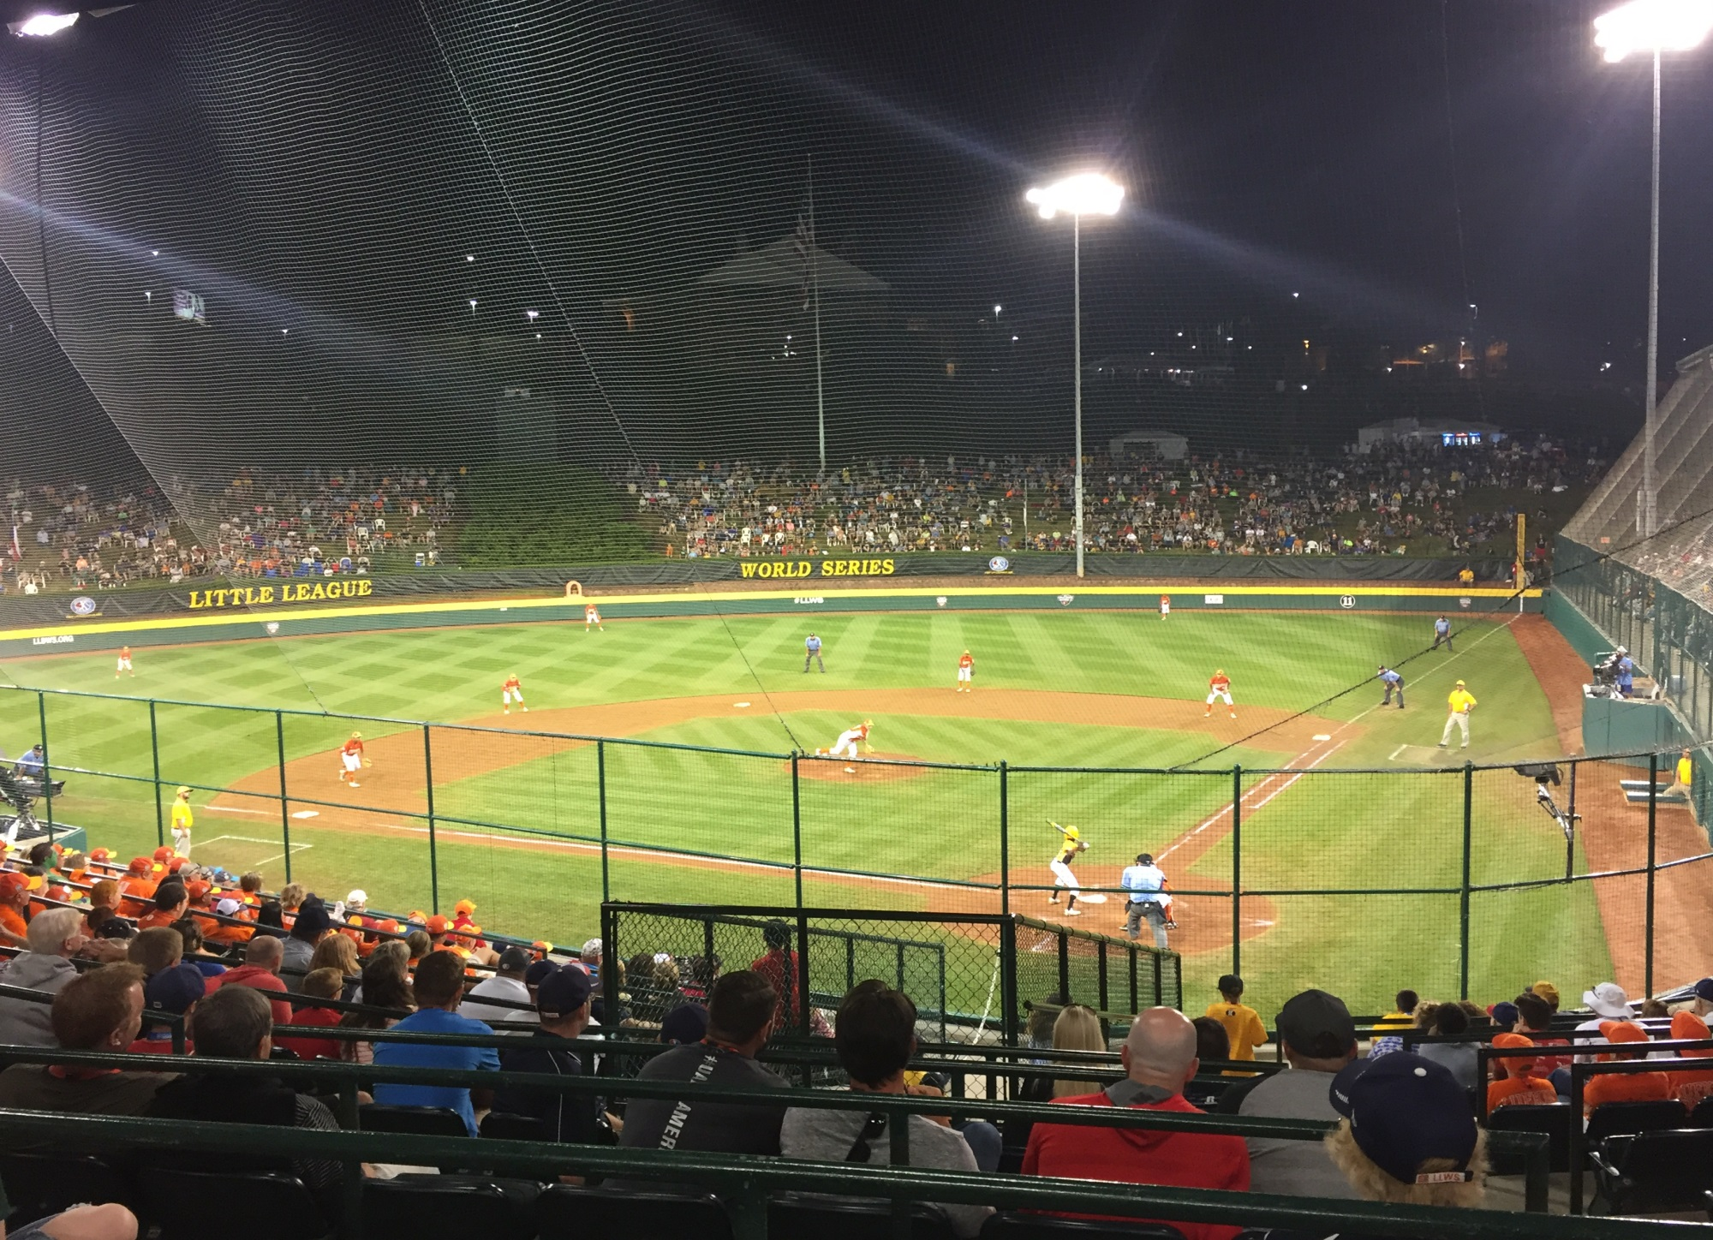

Slide 12
