Slide 1
2024 NFHS Baseball Rule changes Powerpoint

Slide 2
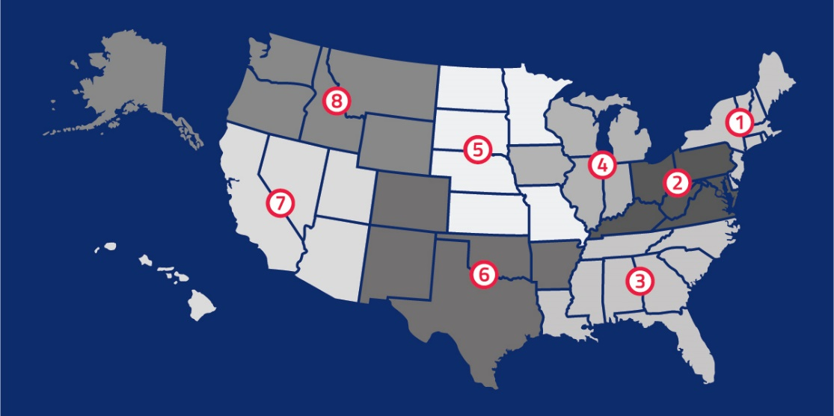
National Federation of State High School Associations
NFHS (located in Indianapolis, IN – Est. 1920):
National leader and advocate for high school athletics and performing arts programs.
Serves 51 state associations, 19,500 high schools and 12 million student participants.
Writes playing rules for 17 high school sports for boys and girls.
Offers online education courses for high school coaches, officials, parents, students and others.
Ensures that students have opportunity to enjoy healthy participation, achievement and good sportsmanship in education-based athletics.

Slide 3
Coaches Uniform
Rule 3-2-1
A coach who is not in the uniform of the team shall be restricted to the bench/dugout.
NFHS: Umpires should know their state association’s requirements and procedures for coaches’ uniform violations.
NJSIAA: Schools shall set the dress code for their coaches. Uniform apparel shall not contain reference to alcohol, drug use or nudity.

Slide 4
Two-Hour Time Limit Sub-varsity
A sub-varsity baseball game may be played under a two-hour time limit.
Home School and/or conference shall make the determination.
Home Coach shall announce whether the two-hour time limit will apply at the pre-game conference.
If applicable, the start of the game shall be when the umpire calls “PLAY”.
The start of an inning begins when the 3rd out of the previous inning is declared.

Slide 5
Two-Hour Time Limit Sub-varsity
For example:
Plate Umpire calls “PLAY” at 4:01.
The third out of the 5th inning is recorded at 6:00. The sixth inning of the game must be played.
Plate Umpire calls “PLAY” at 4:01.
The third out of the 4th inning is recorded at 6:01. Game is over.

Slide 6
Extra Hitter / Defensive Substitution Sub-varsity
A coach may play with one of the following options in sub-varsity play.
9 Batters bat.
10 Batters bat with an extra hitter. Can be any spot in batting order.
Batting order cannot be changed. The starter and any substitute hitter are locked into the position.
Defensively, the coach may interchange the 9 players without regard to the substitution rule.

Slide 7
Extra Hitter / Defensive Substitution Sub-varsity
RATIONALE:
Coaches wanted to give players more opportunities to play.

Slide 8
Amended pitch Count
If a pitcher reaches a pitch limit while facing a batter, the pitcher may continue to pitch until one of the following occurs (except for G above): 1. The batter reaches base, or
2. That batter is retired, or
3. The third out is recorded to complete that half-inning or game.
Note: Once the 150-pitch limit in five calendar days is reached, the pitcher may not continue with the current batter.

Slide 9
Double first Base
NJSIAA will permit if home team chooses to play with this option.

Slide 10
Double First Base
Fielder uses white base
Runner uses colored base which extends the 45 foot lane.

Slide 11
Njsiaa baseball exam
On the NJSIAA website.
Will be open from February 1 though June 1st.
Passing score = 80%.

Slide 12
Umpire registration
Log in to NJSIAA.org
Pay the Registration and Criminal Background Check fee.
Attend an Interpretation Meeting
Take the concussion course and notify your chapter secretary.
Take the Implicit Bias course when open.
Be a member in Good Standing with your Chapter.

Slide 13
Implicit Bias Workshop
Memo: Winter Sports Implicit Bias Make-ups Below you will find the registration links to 6 make-up Winter workshops. Pre-registration is required. Each registration link is unique to the specific date and time. Each session will be limited to 100 participants. Please only register for one session.
Tuesday, January 30th – 4:00pm
Tues day, January 30th – 8:00pm
The link to join the Zoom meeting will be sent in your confirmation email from Zoom. This email is sent right after you successfully register for the session. The email will come from no-reply@zoom.us.
If you do not see it in your inbox, please also check your spam/junk folde rs. If you still cannot locate the email, please email Dena Maggio at dmaggio@njsiaa.org as soon as possible.
Please do not wait until the last minute to ensure you have received this email—it contains the link you need to join the meeting.
NOTES:
Regular season game assignments will NOT be affected by the status of your completion of this workshop. Officials will be ineligible for post-season state tournament assignments without participating in the workshop.
Similar workshops, like the NFHS course, will not be accepted.
These workshops are for WINTER OFFICIALS ONLY. Spring officials will have their own workshops posted at a later date.
Please only register for ONE session. We have many officials registering multiple times and taking much needed spots away from others.
Credit will be confirmed throu gh Zoom attendance reports. Chapters will be sent a list of all officials who have completed the course requirement.
Regards, Tony Maselli
_________ End Memo

Slide 14
Implicit Bias Workshop
Regular season game assignments will NOT be affected by the status of your completion of this workshop. Officials will be ineligible for post-season state tournament assignments without participating in the workshop.
Similar workshops, like the NFHS course, will not be accepted.
These workshops are for WINTER OFFICIALS ONLY. Spring officials will have their own workshops posted at a later date.
Please only register for ONE session. We have many officials registering multiple times and taking much needed spots away from others.
Credit will be confirmed through Zoom attendance reports. Chapters will be sent a list of all officials who have completed the course requirement.

Slide 15
NFHS Rules Review Committee
The NFHS Rules Review Committee is chaired by the chief operating officer and composed of all rules editors. After each committee concludes its deliberations and has adopted its recommended changes for the subsequent year, such revisions will be evaluated by the Rules Review Committee.
Davis Whitfield
Chief Operating Officer
Lindsey Atkinson
Basketball, Girls Lacrosse and Volleyball
Bob Colgate
Football and Sports
Medicine
Sandy Searcy
Softball, Swimming & Diving and Water Polo
Elliot Hopkins
Baseball and Wrestling
Julie Cochran
Cross Country, Gymnastics, Field Hockey, Soccer and
Track & Field
James Weaver
Boys Lacrosse
and Spirit
Dan Schuster
Ice Hockey

Slide 16
Nfhs baseball committee philosophy
“We are the keepers of Amateur Baseball”
NFHS Baseball Committee considers these factors when requests are submitted for rules changes.
Risk Management
Balance between Offense and Defense
Keeping with Tradition in an era where the sport is changing on the professional level and student-athletes are bigger, stronger and faster.

Slide 17
NEW NFHS AllAccess – Website
AllAccess is the New NFHS Digital Publications Platform that includes:
Rules Publications
High School Today Magazine
Policy Debate Quarterlies
Other NFHS Digital Publications
Website organized for associations and individuals to assign books and manage purchases
Visit www.allaccess.nfhs.org

Slide 18
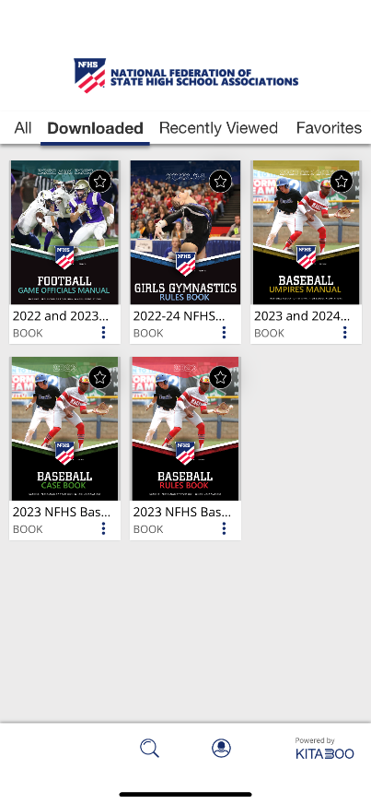
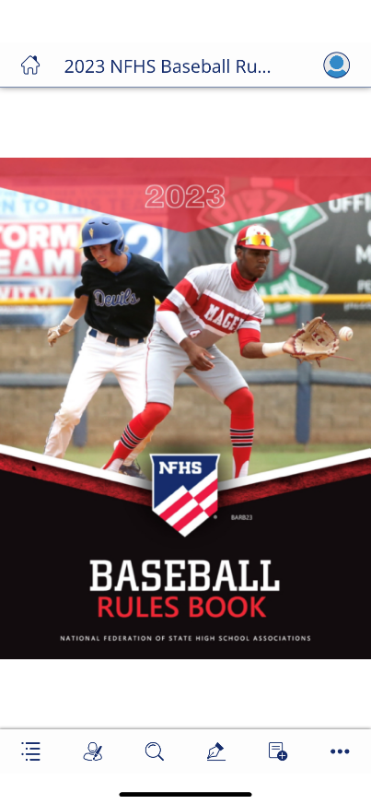
NEW NFHS AllAccess – Mobile App
Access Via Website or Mobile App:
View available publications for sale
View publications assigned to you
Download books for offline viewing
Read publications as an e-book
Book features include:
Table of contents
Highlighting text
Creating ‘sticky notes’ on pages
Searching for terms
Mark-up pen feature
Viewing highlights and notes on data page
Available on App Store and Google Play

Slide 19
2024 NFHS BASEBALL
Rules Changes

Slide 20
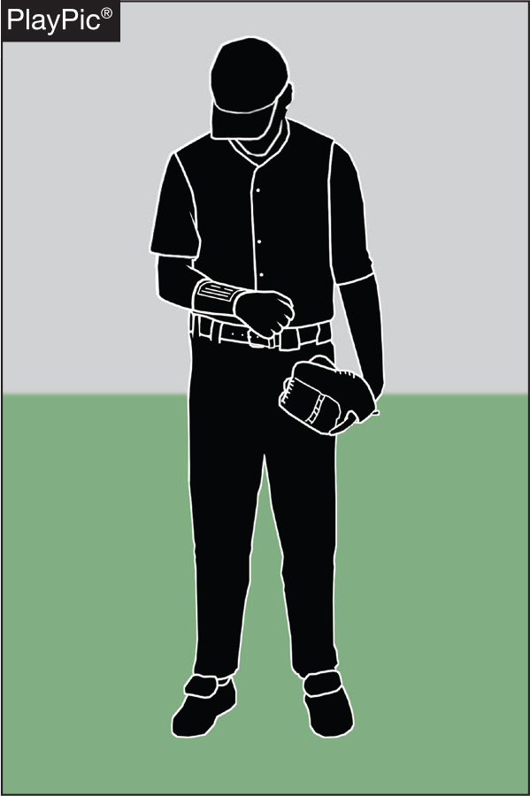
1-6-1 PLAYER COMMUNICATION EQUIPMENT
• Any wristband with defensive shifts/offensive plays/pitching choices or game directions attached shall be considered non-electronic equipment and is permitted as long as it a single, solid color.

Slide 21
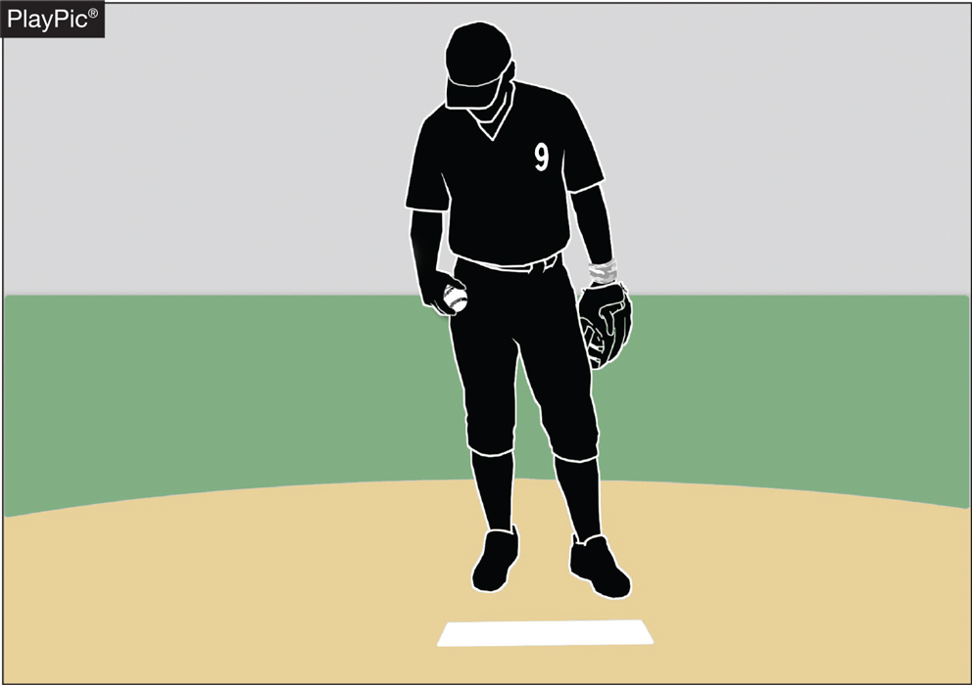
1-6-1 PLAYER COMMUNICATION EQUIPMENT
• For pitchers, it may not contain the colors white, gray or be distracting.
• It does not have to match the color of the uniform or the sleeves worn underneath the uniform.

Slide 22
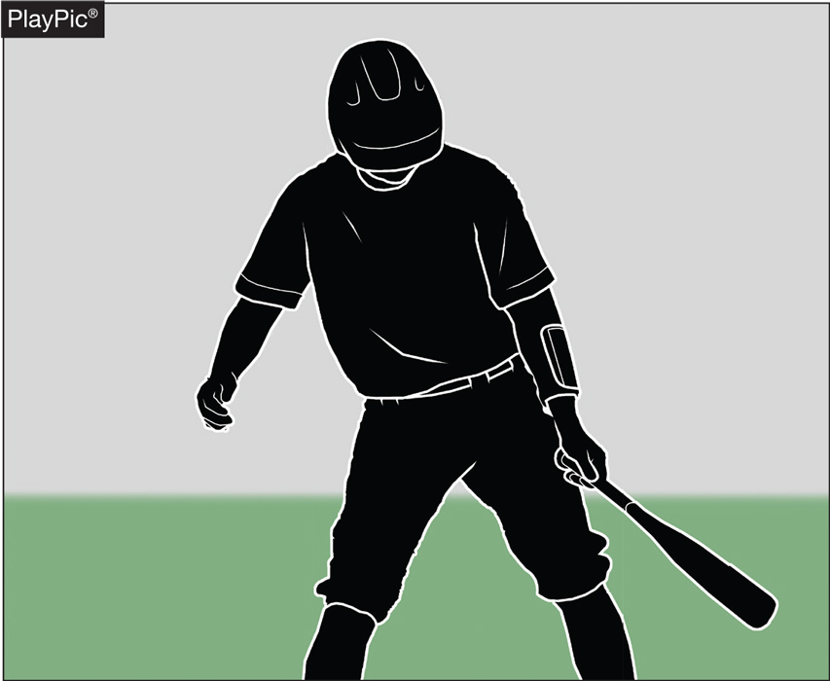
1-6-1 PLAYER COMMUNICATION EQUIPMENT
• It shall only be worn on player(s) wrist or forearm and pitchers shall wear it on their non-pitching arm.
Clarification was needed as many states reported that wrist bands were being worn on the belt. This is now prohibited by rule.

Slide 23
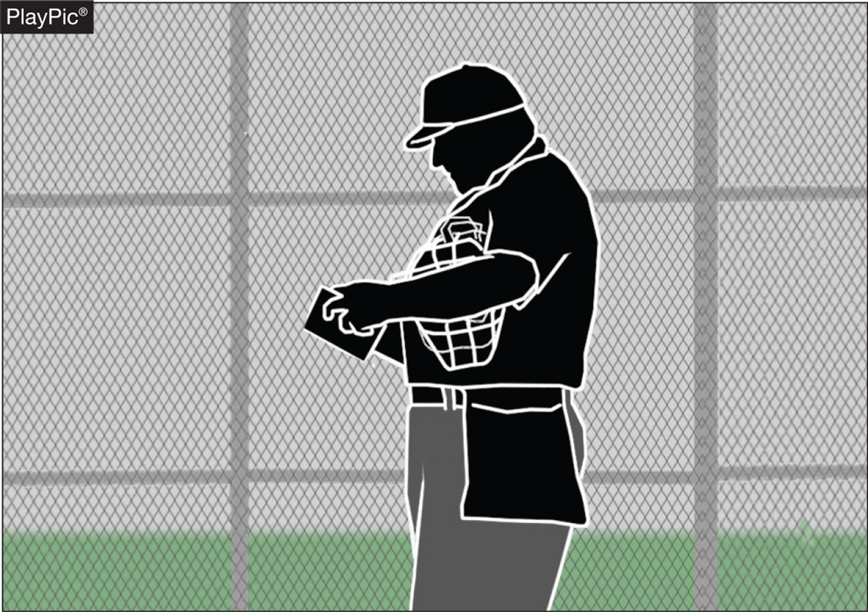
1-6-1 PLAYER COMMUNICATION EQUIPMENT
• The penalty for wearing this equipment improperly is a team warning to the coach on a first offense.
• The next offender of that team will be ejected along with the team’s head coach.

Slide 24
player communication equipment Rule 1-6-1 (New section)
ART. 1 . . . Any wristband with defensive shifts/offensive plays/pitching choices or game directions attached shall be considered non-electronic equipment and is permitted as long as it is a single, solid color. For pitchers, it may not contain the colors white, gray or be distracting. It does not have to match the color of the uniform or the sleeves worn underneath the uniform. It shall only be worn on a player(s) wrist or forearm and pitchers shall wear it on their non-pitching arm.
PENALTY: The umpire shall issue a team warning to coach of the team involved and the next offender(s) of that team will be ejected along with the head coach.
Rationale:
Clarification. With the increase in popularity of these style of communication systems, confusion has been realized when the players wear them other than on their arm. This change will prohibit these types of products from being worn other places.

Slide 25
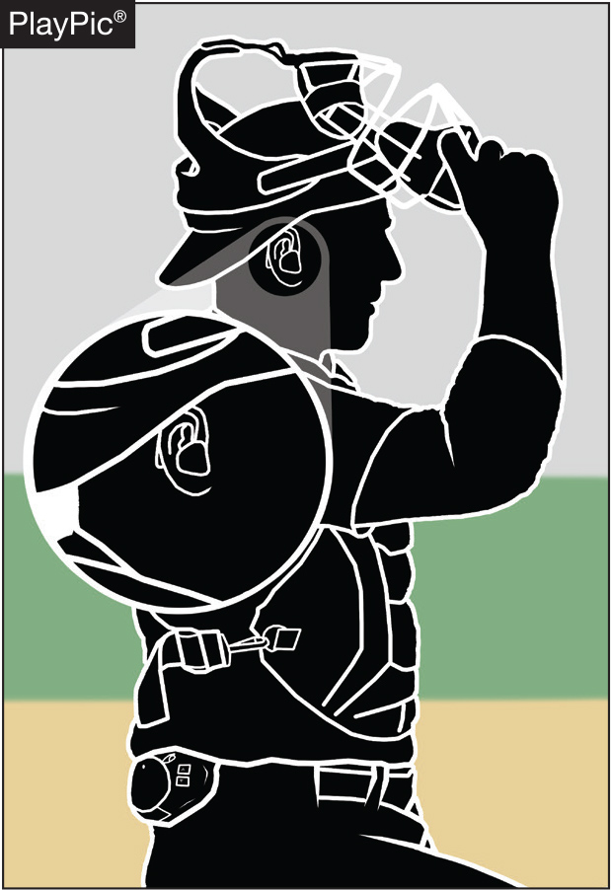
PLAYER COMMUNICATION EQUIPMENT rule 3-2-5
• One-way electronic communication devices are permissible from the dugout to the catcher while the team is on defense for the purpose of calling pitches.

Slide 26
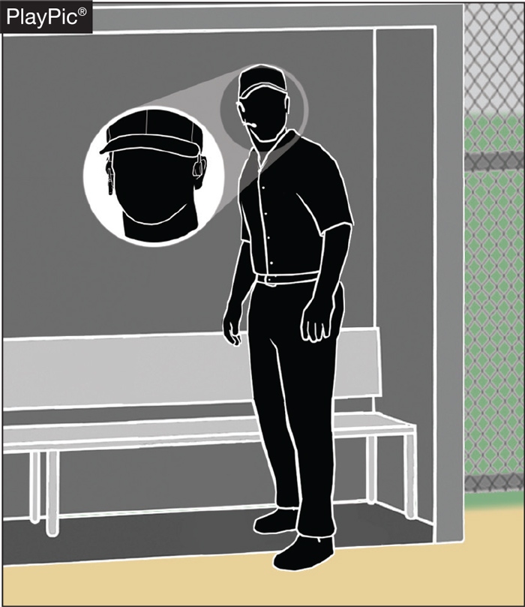
PLAYER COMMUNICATION EQUIPMENT rule 1-6-2
• When using the electronic communication device, the coach cannot be outside the dugout/bench area.

Slide 27
player communication equipment Rule 1-6-2 (New section)
ART. 2 . . . One-way electronic communication devices are permissible from the dugout to the catcher while the team is on defense for the purpose of calling pitches. When using the electronic communication device, the coach cannot be outside the dugout/bench area.
PENALTY: The umpire shall issue a team warning to coach of the team involved and the next offender(s) of that team will be ejected along with the head coach.
Rationale:
This rule allows for a team to utilize an electronic device for the purpose of calling pitches from the dugout. The device would only be able to be one-way, meaning the player cannot use an electronic device to respond or communicate back to the coach. Various technologies, earpiece, electronic band or a smart watch could be used giving teams several options at varying costs. No other player would be able to wear or use this device nor would the coach be able to communicate with any other player using electronic communication.

Slide 28
Nfhs does not recommend equipment
At a recent coaches convention, vendors displayed communication devices claiming that they are NFHS approved.
Only vendors that have a license with NFHS are permitted to place the NFHS logo on equipment.

Slide 29
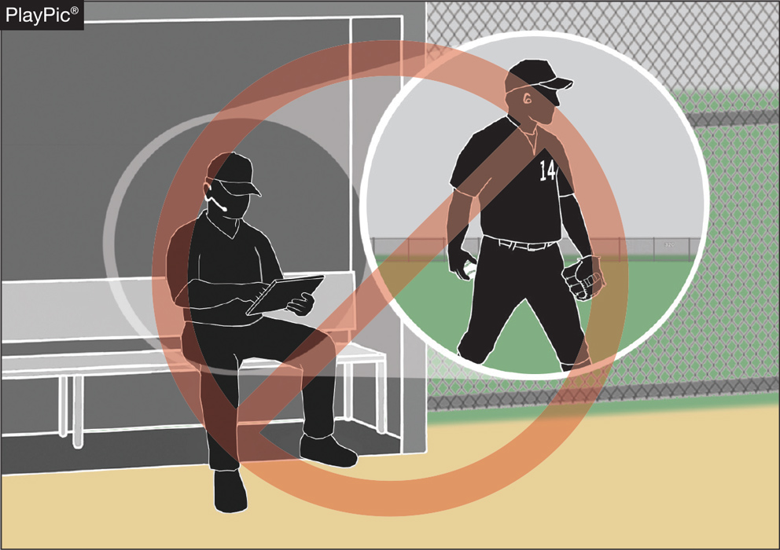
COACHING (PLAYER COMMUNICATION EQUIPMENT) rule 3-2-5
• Coaches may not use electronic communication device(s) to communicate with any other team member than the catcher while on defense, or any team member while on offense.

Slide 30
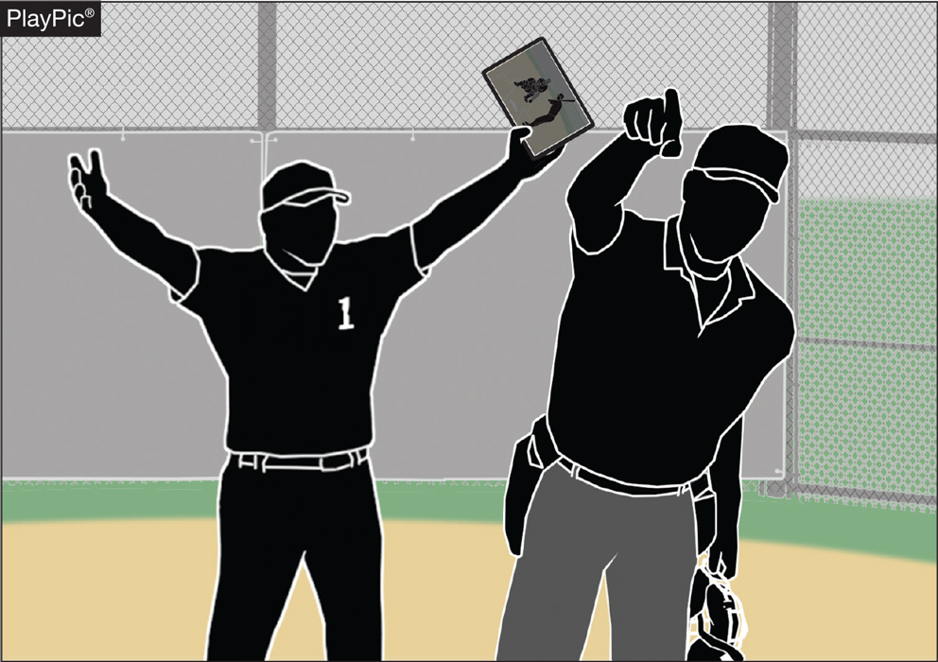
COACHING (PLAYER COMMUNICATION EQUIPMENT) rule 3-2-5
• The penalty for improper use is a team warning on the first offense.
• The next offender of that team will be ejected, along with the team’s head coach.

Slide 31
Coaching rule 3-2-5
ART. 5 . . . A coach may use a one-way electronic communication device to communicate to the catcher for the purpose of calling pitches. Coaches may not use electronic communication device(s) to communicate with any other team member while on defense or any team member while on offense. When using the electronic communication device, the coach cannot be outside the dugout/bench area.
PENALTY: The umpire shall issue a team warning to coach of the team involved and the next offender(s) of that team will be ejected along with the head coach.
Rationale:
Allows for the coach to communicate with the catcher using an electronic communication device for the purpose of calling pitches.

Slide 32
Pilot programs
Louisiana and North Dakota applied for and was granted permission to experiment with equipment that will test the use of electronic communication devices with multiple defensive players.
Yearly reports with data must reported to NFHS.
After 3 years, those states would be eligible to submit a rules change proposal to permit this.

Slide 33
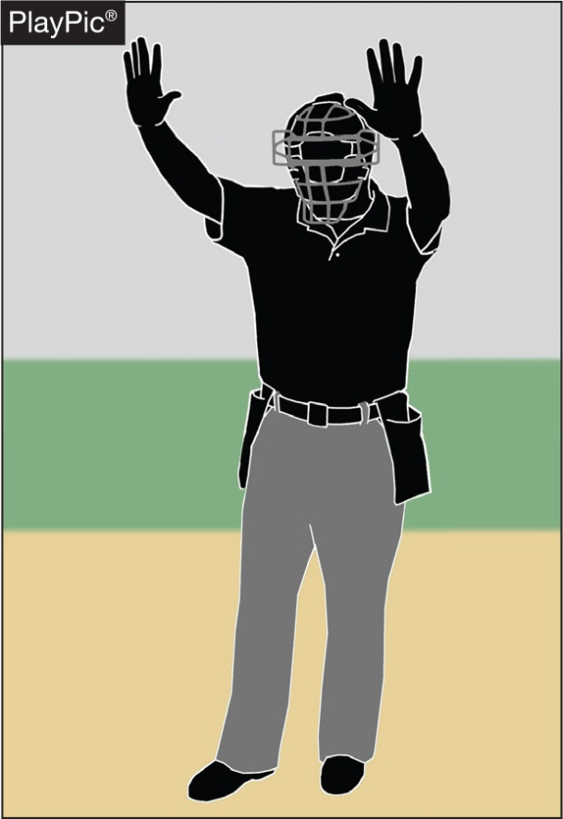
UMPIRE-IN-CHIEF Rule 10-2-3h
• The umpire-in-chief may forfeit the game for prescribed infractions by coaches, players or team/bench personnel.
Rule change eliminated Spectators from the statement.
Dealing with unruly fans are not the role of the umpire-in-chief.
Utilize Site Management.
Read and Understand the NJSIAA Termination of Game procedure.

Slide 34
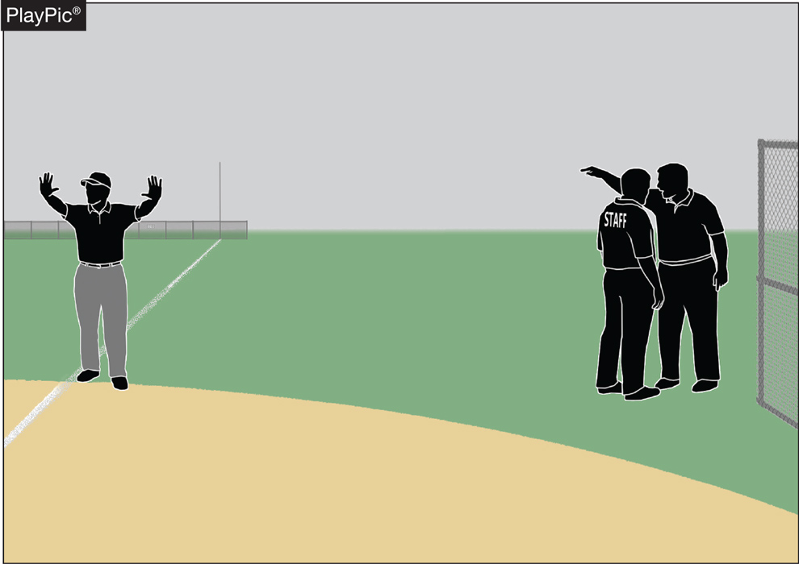
UMPIRE-IN-CHIEF Rule 10-2-3h
• Umpires have jurisdiction over the confines of the players, coaches and team/bench personnel.
• If there are issues with spectators, it is the responsibility of game management to deal with spectators and to ensure the facility is safe for all involved.

Slide 35
UMPIRE-IN-CHIEF rule 10-2-3h
h. Forfeit the game for prescribed infractions by spectators, coaches, players or team/bench personnel.
Rationale:
Umpires have jurisdiction over the confines of the field, players, coaches and team/bench personnel. If there are issues with spectators, it is the responsibility of game management to deal with spectators and to ensure that the facility is safe for all involved.

Slide 36
2024 NFHS BASEBALL
Points of Emphasis

Slide 37
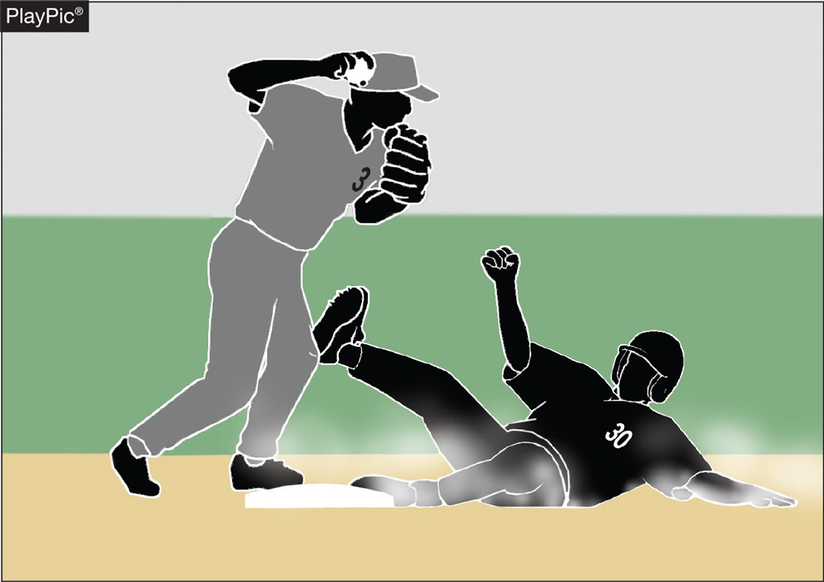
Malicious contact
Malicious contact can be initiated by either an offensive or defensive player(s).
It should not be confused with incidental contact or “train wreck” plays that sometimes occur in baseball.
Notes:
NFHS playing rules are written to encourage sportsmanship. Participation in these programs should promote respect, integrity and sportsmanship. However, for these ideals to occur, everyone involved in these programs must be doing their part.
Sportsmanship, or good sporting behavior, is about treating one another with respect and exhibiting appropriate behavior. It is about being fair, honest and caring. When these types of appropriate behavior occur, competitive play is more enjoyable for everyone.

Slide 38
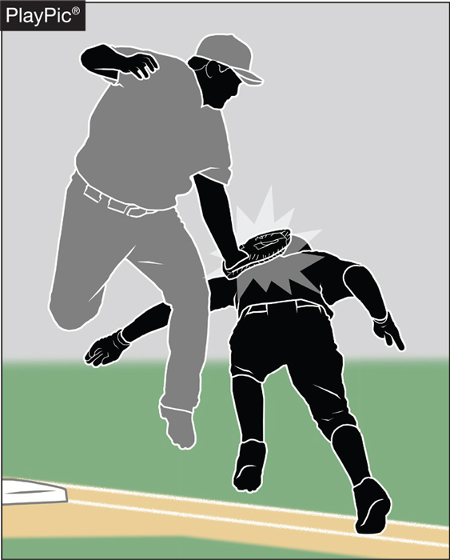
Malicious contact
Contact or a collision is considered to be malicious if it is the result of excessive force and/or there is an intent to injure.
The absence of these two conditions does not preclude the presence of malicious contact but would provide a reasonable starting point for proper interpretation.
Notes:
NFHS playing rules are written to encourage sportsmanship. Participation in these programs should promote respect, integrity and sportsmanship. However, for these ideals to occur, everyone involved in these programs must be doing their part.
Sportsmanship, or good sporting behavior, is about treating one another with respect and exhibiting appropriate behavior. It is about being fair, honest and caring. When these types of appropriate behavior occur, competitive play is more enjoyable for everyone.

Slide 39
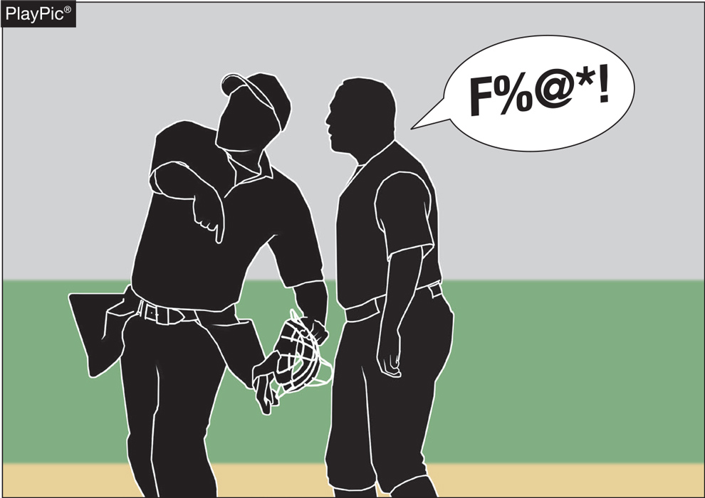
Profanity (DIRECT OR INDIRECT)
Education-based athletics is a direct extension of the classroom.
There is no excuse for foul language in school or on the baseball field.
If a teacher would not allow profane language in the classroom, why would a coach permit it on the field?
Notes:
NFHS playing rules are written to encourage sportsmanship. Participation in these programs should promote respect, integrity and sportsmanship. However, for these ideals to occur, everyone involved in these programs must be doing their part.
Sportsmanship, or good sporting behavior, is about treating one another with respect and exhibiting appropriate behavior. It is about being fair, honest and caring. When these types of appropriate behavior occur, competitive play is more enjoyable for everyone.

Slide 40
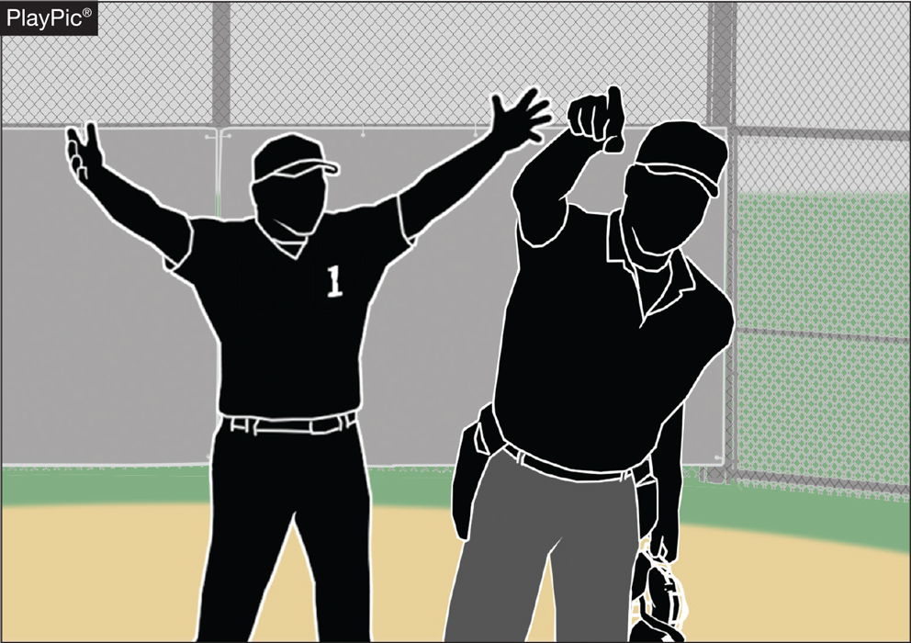
Profanity (DIRECT OR INDIRECT)
The penalties are a verbal warning to the offender on the first offense; a written warning to the offender that warrants restriction to the dugout/bench for the remainder of the game for a second offense; or ejection for a major offense.
Notes:
NFHS playing rules are written to encourage sportsmanship. Participation in these programs should promote respect, integrity and sportsmanship. However, for these ideals to occur, everyone involved in these programs must be doing their part.
Sportsmanship, or good sporting behavior, is about treating one another with respect and exhibiting appropriate behavior. It is about being fair, honest and caring. When these types of appropriate behavior occur, competitive play is more enjoyable for everyone.

Slide 41
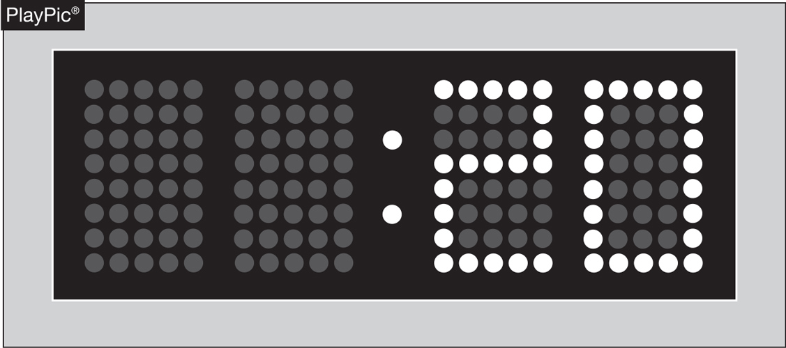
PACE OF PLAY
A 20-second time limit rule has been in the NFHS rules book since the 1970s.
The rule is meant to only be utilized when other preventive umpiring measures fail to achieve a reasonable pace or rhythm.
Notes:
NFHS playing rules are written to encourage sportsmanship. Participation in these programs should promote respect, integrity and sportsmanship. However, for these ideals to occur, everyone involved in these programs must be doing their part.
Sportsmanship, or good sporting behavior, is about treating one another with respect and exhibiting appropriate behavior. It is about being fair, honest and caring. When these types of appropriate behavior occur, competitive play is more enjoyable for everyone.

Slide 42
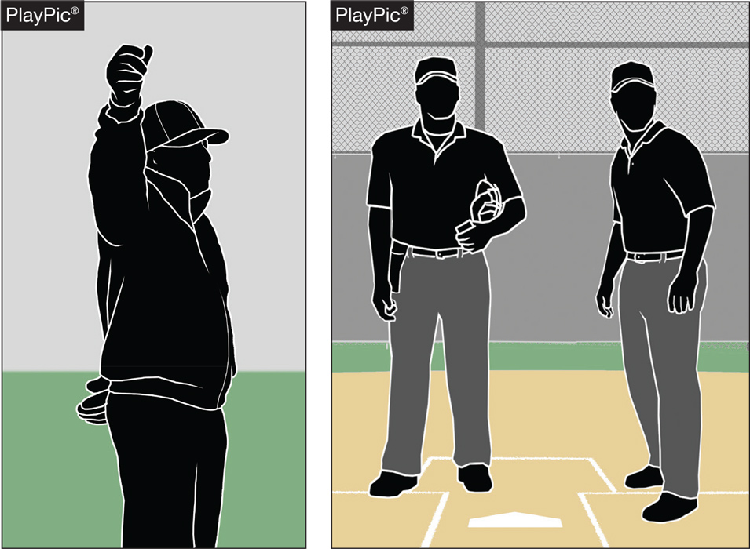
PACE OF PLAY
By rule, the time between the last out of one half-inning and the first pitch of the next half-inning is 1 minute, 20 seconds.
Umpires should facilitate this and refrain from visiting with fans or having prolonged discussions with other crew members.
Notes:
NFHS playing rules are written to encourage sportsmanship. Participation in these programs should promote respect, integrity and sportsmanship. However, for these ideals to occur, everyone involved in these programs must be doing their part.
Sportsmanship, or good sporting behavior, is about treating one another with respect and exhibiting appropriate behavior. It is about being fair, honest and caring. When these types of appropriate behavior occur, competitive play is more enjoyable for everyone.

Slide 43
Pace of play guidelines
These rules were put in effect in 1978.
NFHS has not received concerns and is not aware of any issue.
NCAA took action to speed up the pace of play in 2023.
Some umpires who work collegiate and high school baseball began to utilize those rules in high school games incorrectly.

Slide 44
Pace of play
Umpires should not look for trouble.
Rules should be used if pace of play violations are excessive or intentional.
Umpires need to be proactive in getting teams on and off the field between innings.
Data collected nationwide found that the average high school game lasts 2 hours and 9 minutes.

Slide 45
Pace of play
Umpires should use preventive officiating if necessary to speed up play.
Talk to catcher
Talk to pitcher
Talk to coach

Slide 46
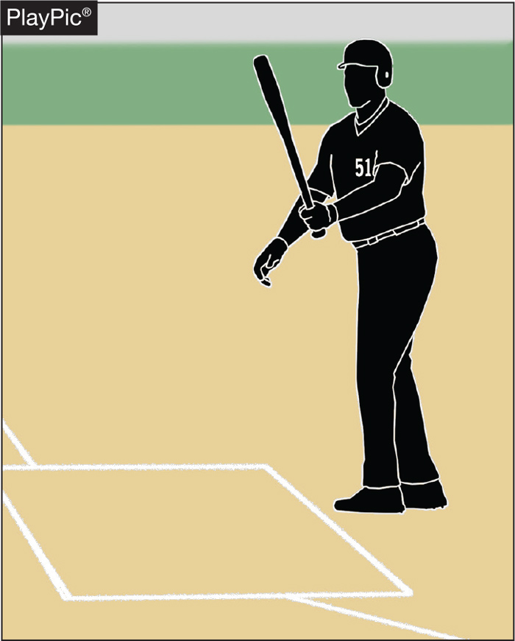
PACE OF PLAY
Rule 7-3-1 spells out the situations when a batter is allowed to leave the batter’s box.
Repeatedly stepping out to alter the rhythm of the pitcher or delay the game is not acceptable, and umpire needs to apply the proper penalty.
Notes:
NFHS playing rules are written to encourage sportsmanship. Participation in these programs should promote respect, integrity and sportsmanship. However, for these ideals to occur, everyone involved in these programs must be doing their part.
Sportsmanship, or good sporting behavior, is about treating one another with respect and exhibiting appropriate behavior. It is about being fair, honest and caring. When these types of appropriate behavior occur, competitive play is more enjoyable for everyone.

Slide 47
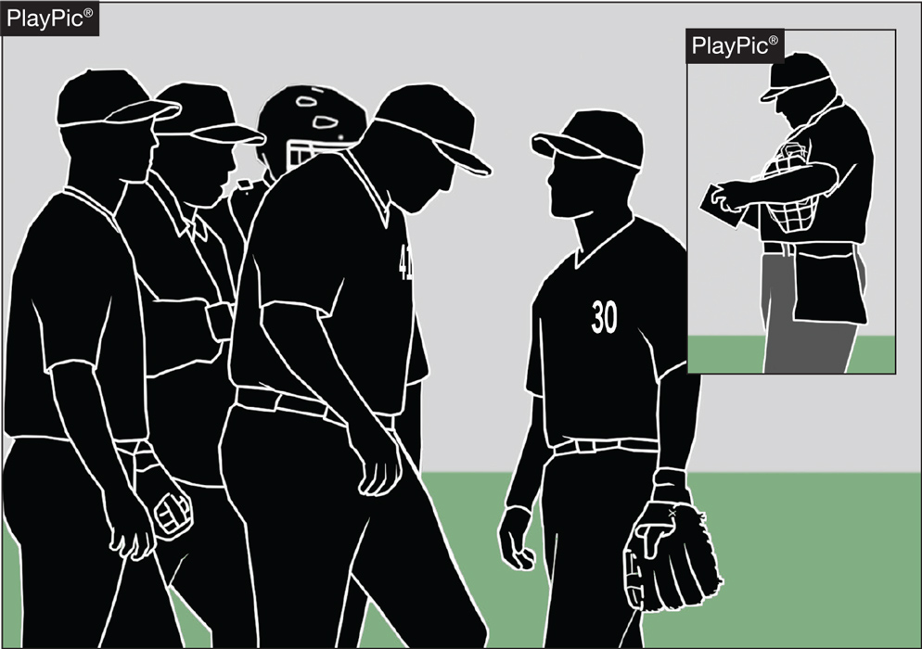
PACE OF PLAY
Umpires need to be consistent in monitoring how teams get on/off the field, conferences, enforcing the batter’s box rule and in other areas to create a sense of urgency during the contest.
Notes:
NFHS playing rules are written to encourage sportsmanship. Participation in these programs should promote respect, integrity and sportsmanship. However, for these ideals to occur, everyone involved in these programs must be doing their part.
Sportsmanship, or good sporting behavior, is about treating one another with respect and exhibiting appropriate behavior. It is about being fair, honest and caring. When these types of appropriate behavior occur, competitive play is more enjoyable for everyone.

Slide 48
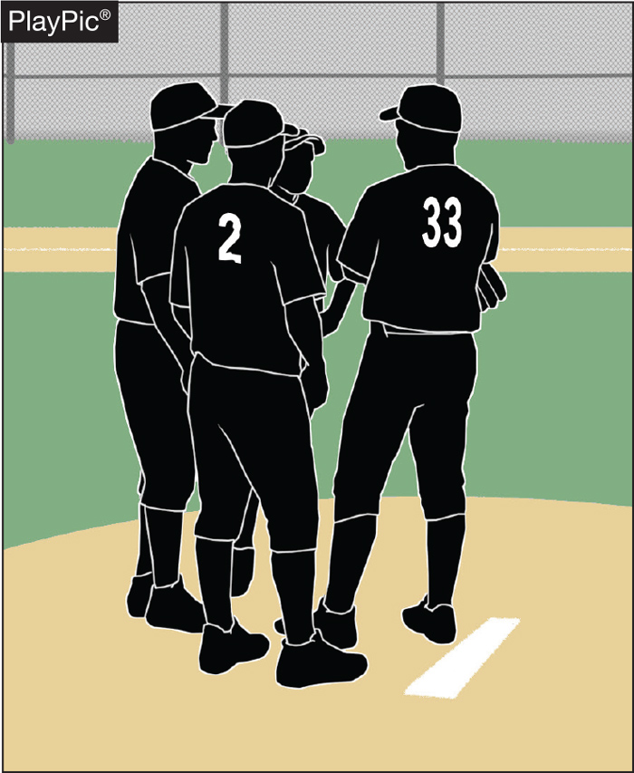
PACE OF PLAY
Umpires need to recognize when excessive player conferences begin to delay the game, step in and expedite the conclusion of the meeting.
Notes:
NFHS playing rules are written to encourage sportsmanship. Participation in these programs should promote respect, integrity and sportsmanship. However, for these ideals to occur, everyone involved in these programs must be doing their part.
Sportsmanship, or good sporting behavior, is about treating one another with respect and exhibiting appropriate behavior. It is about being fair, honest and caring. When these types of appropriate behavior occur, competitive play is more enjoyable for everyone.

Slide 49
NFHS OFFICIALS Education

Slide 50
OFFICIALS EDUCATION
Content remains free of charge
TEACHING
AIDS
RULES
CHANGES
DIAGRAMS
VIDEO
LIBRARY
OFFICIALS
COURSES
Notes:
Sport-Specific Officiating courses are offered in several sports. They are ideal for new officials and those in the first few years of officiating. These courses introduce officials to the mechanics and techniques used in the sport and provide specific information on an area within that sport. Individuals can complete a course within 30-45 minutes. These courses are free to all officials and prospective officials.
“Interscholastic Officiating” is a general course on sports officiating, and it is free to all officials and prospective officials. This course provides an introduction to skills and concepts used as an official. Several topics are covered such as: basics of becoming and staying an official, science of officiating, art of officiating, how to combine these skills for successful officiating.
Video clips are made available to NFHS Officials Association members. The video is clipped on specific topics and provides the rules references as well as dialogue on the topic.
The courses and videos are offered at www.NFHSLearn.com .
Courses Available:
Officiating Football
Officiating Volleyball – Ball Handling
Officiating Volleyball – Alignment
Officiating Volleyball – E-Whistle
Officiating Basketball
Officiating Basketball – Three-Person Mechanics
Officiating Basketball - Pre-Game Conference
Soccer – Fouls and Misconduct
Soccer – Offside
Soccer - Pre-Game Conference
Swimming and Diving
Officiating Wrestling
Umpiring Softball
Officiating Field Hockey
Officiating Track and Field
Future Courses to be Considered:
Umpiring Baseball
Umpiring Softball – 2 Person Mechanics
Communication Among Officials and Coaches

Slide 51
Thank You
National Federation of State High School Associations PO Box 690 | Indianapolis, IN 46206 Phone: 317-972-6900 | Fax: 317.822.5700 www.nfhs.org | www.nfhslearn.com | www.nfhsnetwork.com

